Slide 1
PulseSync: An Efficient and Scalable Clock Synchronization Protocol
Christoph Lenzen, Philipp Sommer, and Roger Wattenhofer
2020.02.26

Slide 2
Problem
Challenges
• Accuracy
• Latency
• Efficiency
Problem：
Existing protocols fail to achieve timely and accurate synchronization over larger distances.
Most existing synchronization protocols cannot adapt quickly to changes in clock drifts or network connectivity.

Slide 3
Contributions
Timely and accurate synchronization over large distances in multi hop networks
Adapt quickly to changes in clock drifts or network connectivity by flooding rapid, short “pulses” through the network.
Save energy : there is no need for nodes to listen between pulses once they detected any pulse, both on initialization or when joining the network later on.

Slide 4
Model
a wireless network
the network as a static graph G = (V,E)
Focus on the following aspects:
Communication is expensive ： nodes send and receive one message per beacon interval B only.
Communication is inexact ： model them as independently distributed random variables and refer to the respective standard deviation as jitter J.
Sending times are constrained ： define the time it takes in each beacon interval between a node receiving and sending a message to be predefined and immutable by the algorithm.
Message size is constrained ： restrict the “payload” of a message to a small (constant) number of values.
Dynamics ： addressed by the proposed algorithm, which strives for dependency of computed clock values on a short period of time.

Slide 5



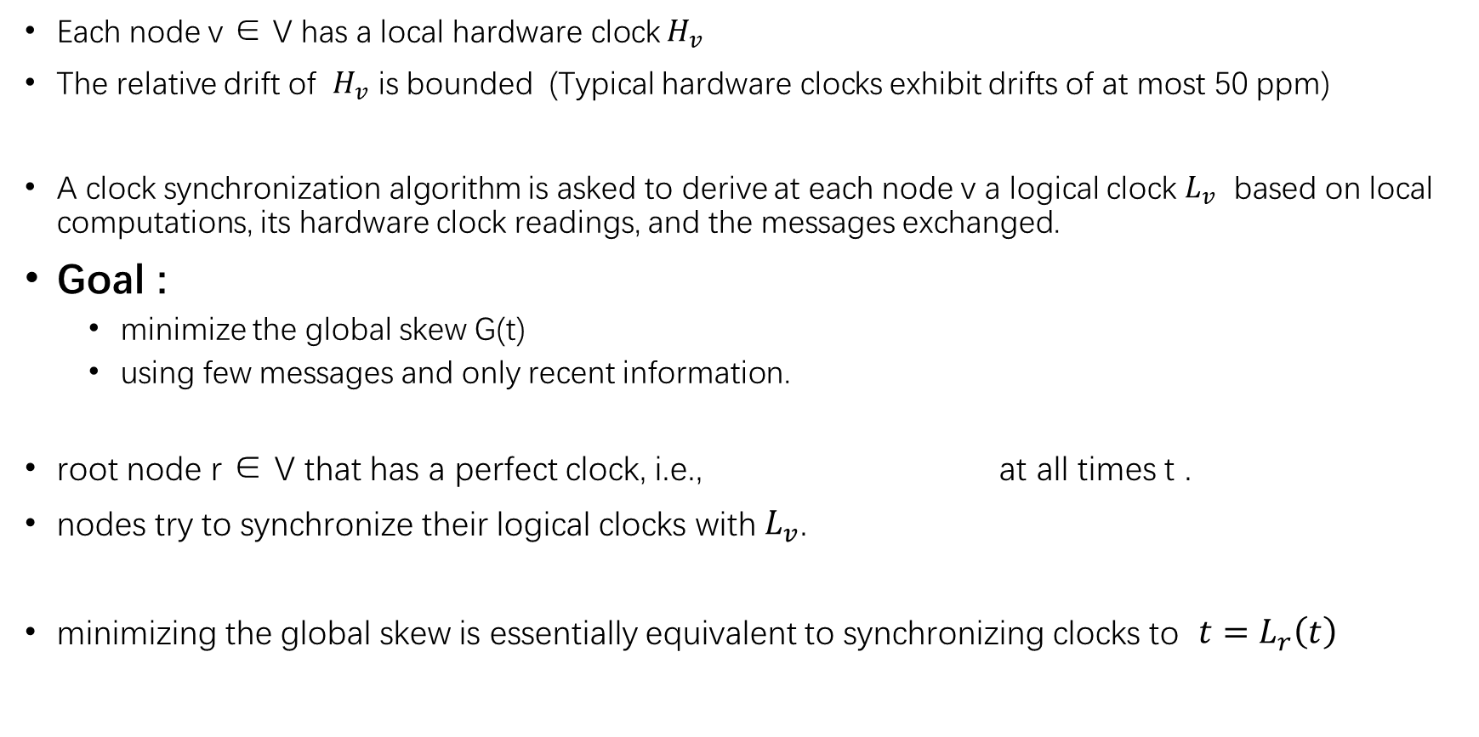
Formalize the problem
Each node v ∈ V has a local hardware clock $H_{v}$
The relative drift of $H_{v}$ is bounded (Typical hardware clocks exhibit drifts of at most 50 ppm)
A clock synchronization algorithm is asked to derive at each node v a logical clock $L_{v}$ based on local computations, its hardware clock readings, and the messages exchanged.
Goal :
minimize the global skew G(t)
using few messages and only recent information.
root node r ∈ V that has a perfect clock, i.e., at all times t .
nodes try to synchronize their logical clocks with $L_{v}$.
minimizing the global skew is essentially equivalent to synchronizing clocks to ${t=L}_{r}\left(t\right)$

Slide 6
PulseSync
The central idea : distribute information on clock values as fast as possible, while minimizing the number of messages required to do so.
a node cannot forward any information it has not received yet
node ought to forward the derived estimate as quickly as possible
To keep the number of hops small : the flooding takes place on a breadth-first search (BFS) tree.
how nodes that are not children of the root obtain accurate estimates of r’s clock
Simple Forwarding
Drift Compensation

Slide 7


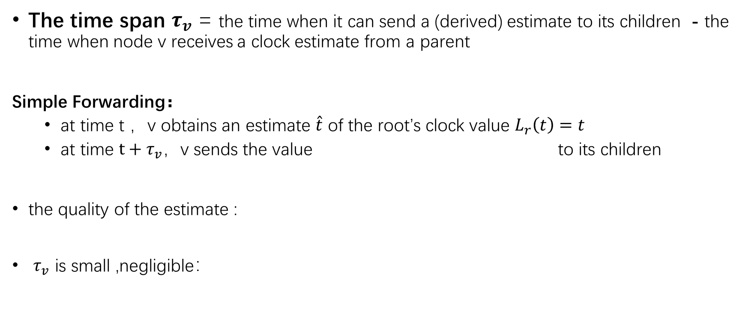
Simple Forwarding
The time span $τ_{v}$ = the time when it can send a (derived) estimate to its children - the time when node v receives a clock estimate from a parent
Simple Forwarding：
at time t ，v obtains an estimate $\hat{t}$ of the root’s clock value $L_{r}\left(t\right)=t$
at time $t+τ_{v}，$v sends the value to its children
the quality of the estimate :
$τ_{v}$ is small ,negligible：

Slide 8
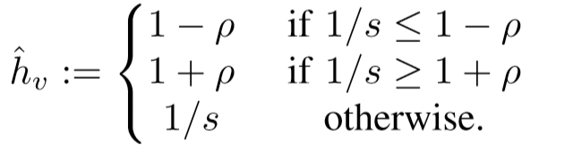


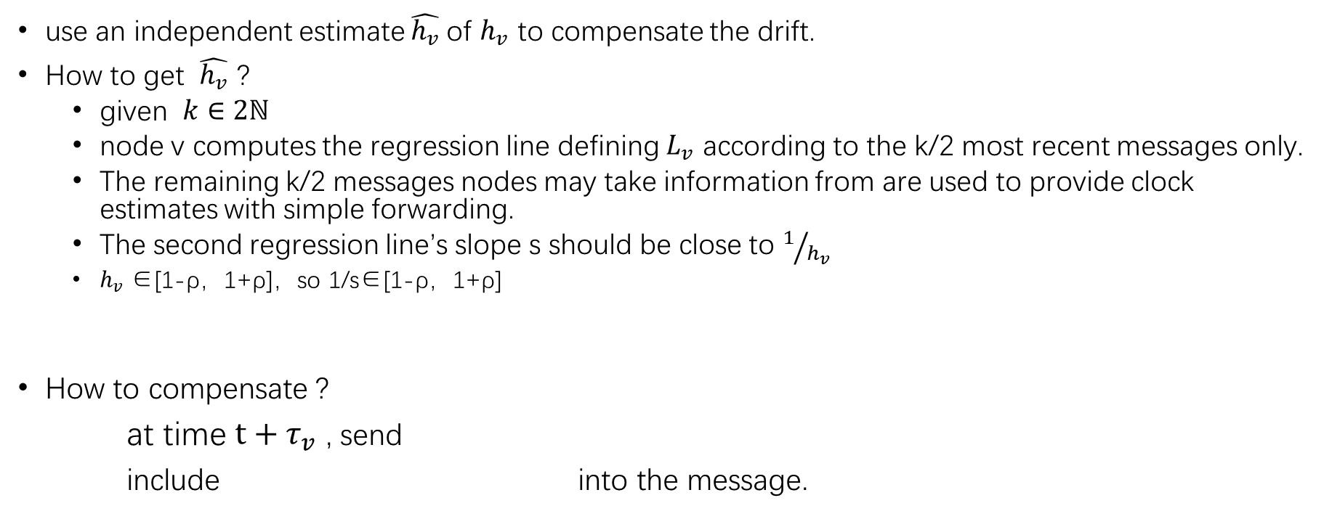
Drift Compensation
use an independent estimate $\hat{h_{v}}$of $h_{v}$ to compensate the drift.
How to get $\hat{h_{v}}$ ?
given $k∈2ℕ$
node v computes the regression line defining $L_{v}$ according to the k/2 most recent messages only.
The remaining k/2 messages nodes may take information from are used to provide clock estimates with simple forwarding.
The second regression line’s slope s should be close to $1/{h_{v}}$
$h_{v}$∈[1-ρ，1+ρ]，so 1/s∈[1-ρ，1+ρ]
How to compensate ?
at time $t+τ_{v}$ , send
include into the message.

Slide 9
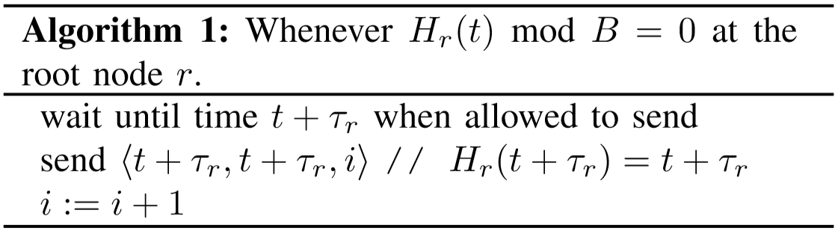
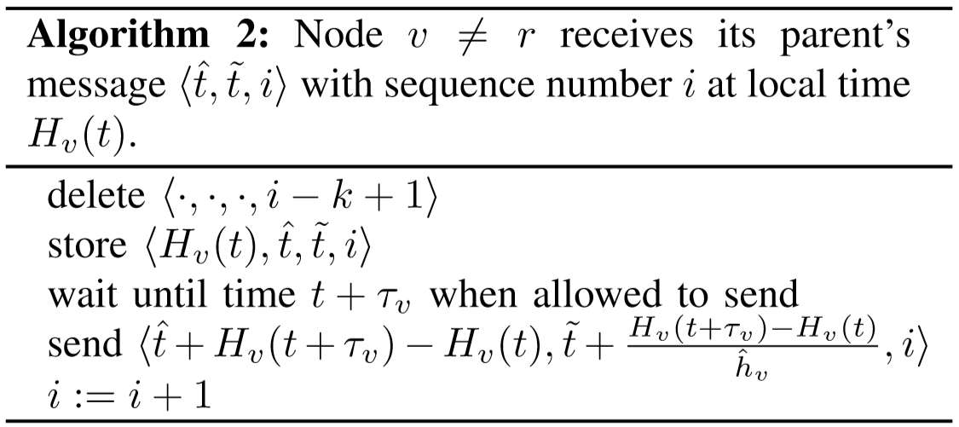
Pseudocode

Slide 10
IMPLEMENTATION
OS：TinyOS 2.x
Hardware Platform：the Opal wireless sensor network platform
The hardware clock is built on top of a 16-bit hardware clock register plus an additional 16-bit software counter
PulseSync Implementation：
Initialization phase：
setting the logical clock to the current hardware clock value
nodes start overhearing the wireless channel for synchronization messages
The bootstrap phase：
If no synchronization messages have been received for a certain time, the node will declare itself as the reference node and starts to broadcast periodic synchronization pulses.
Then:
a node will receive periodic pulses from nodes located closer to the reference node

Slide 11
EVALUATION
Compare ：Flooding Time synchronization Protocol（FTSP）
A. Testbed Setup
an indoor testbed of 31 Opal nodes, which are placed in close proximity
a network diameter of 30 hops
B. Measurement Results
a four hour run
roughly 44,600 data points were collected
almost no packet loss

Slide 12
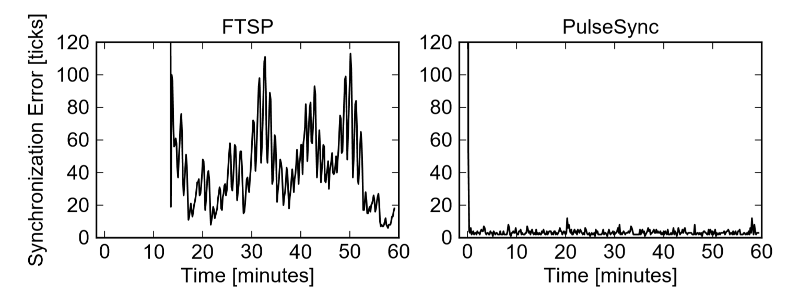
EVALUATION
Initialization Phase

Slide 13
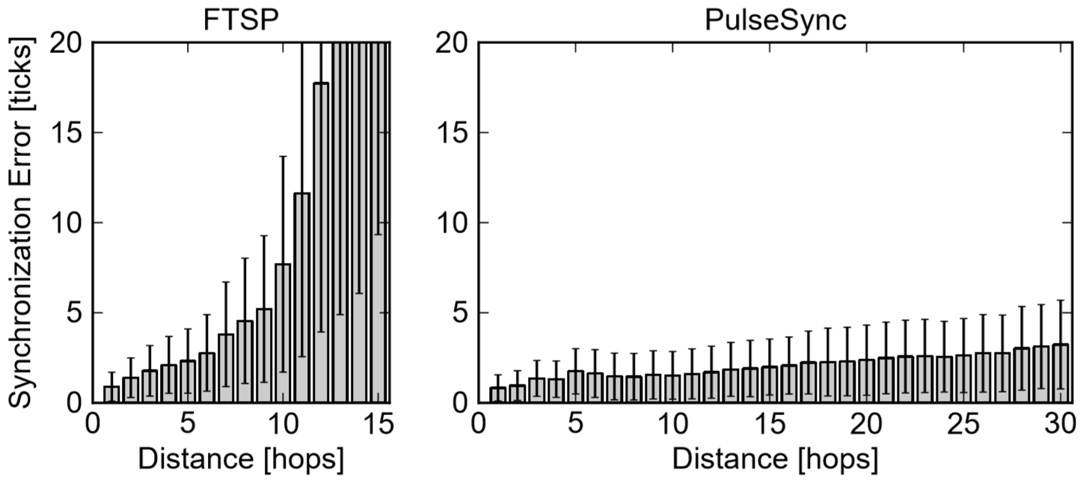
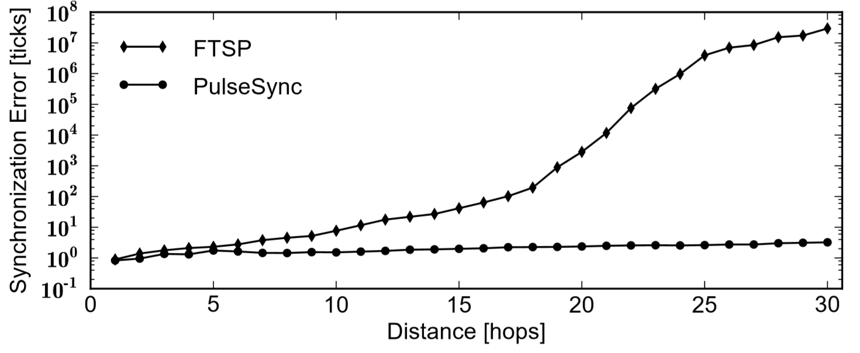
EVALUATION
Synchronization Accuracy

Slide 14
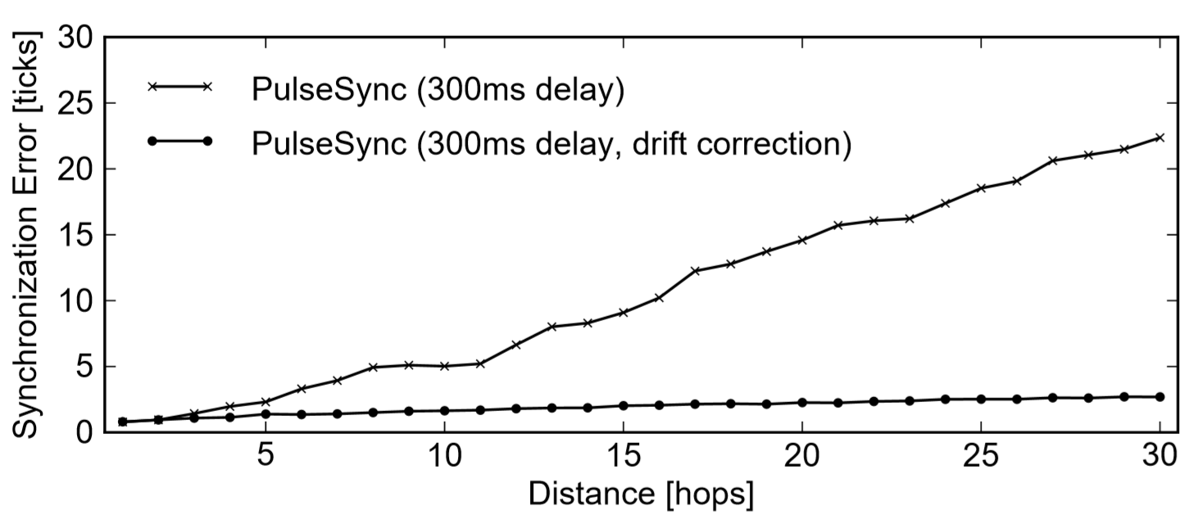
EVALUATION
Slow Forwarding of Clock Estimates
nodes wait 300 milliseconds before forwarding the received clock estimates

Slide 15
Thanks

